Slide 1
Law of the Air space and the ADIZ
Shamshad Ahmad Khan, PhD

Slide 2
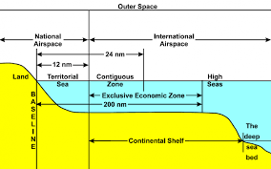
Origin of the Law of Airspace
Law of Airspace has evolved in 3 stages:
1. Paris Convention for the Regulation of Aerial Navigation (1919)
2. Convention on International Civil Aviation/Chicago Convention (1944)
3. UNCLOS (1984)

Slide 3
Paris Convention for the Regulation of Aerial Navigation
Paris convention was based on the concept of Caelum Liberum (freedom of the Sky)
The airspace above the Sea is free as the sea itself. (Beyond territorial water, no one has sovereignty over the Sea)
Note: Sea at that time was divided only into Territorial Water and the High Sea(The continuity has been maintained in UNCLOS)

Slide 4
Convention on International Civil Aviation/Chicago Convention
The Chicago convention clubbed the law of both Territorial air space as well as airspace over Sea.
Countries that signed this convention agreed to respect each others’ sovereignty
Agreed that “special authorization would be needed to fly military aircraft in air space above other State’s sovereign territory.”

Slide 5
ICAO, Five freedoms
These Five Freedoms of the Air are:
Freedom of peaceful transit.
Freedom of non-traffic stop (to refuel, repair, or refuge).
Freedom to take traffic from the homeland to any country.
Freedom to bring traffic from any country to the homeland.
Freedom to pick up and discharge traffic at intermediate points.

Slide 6
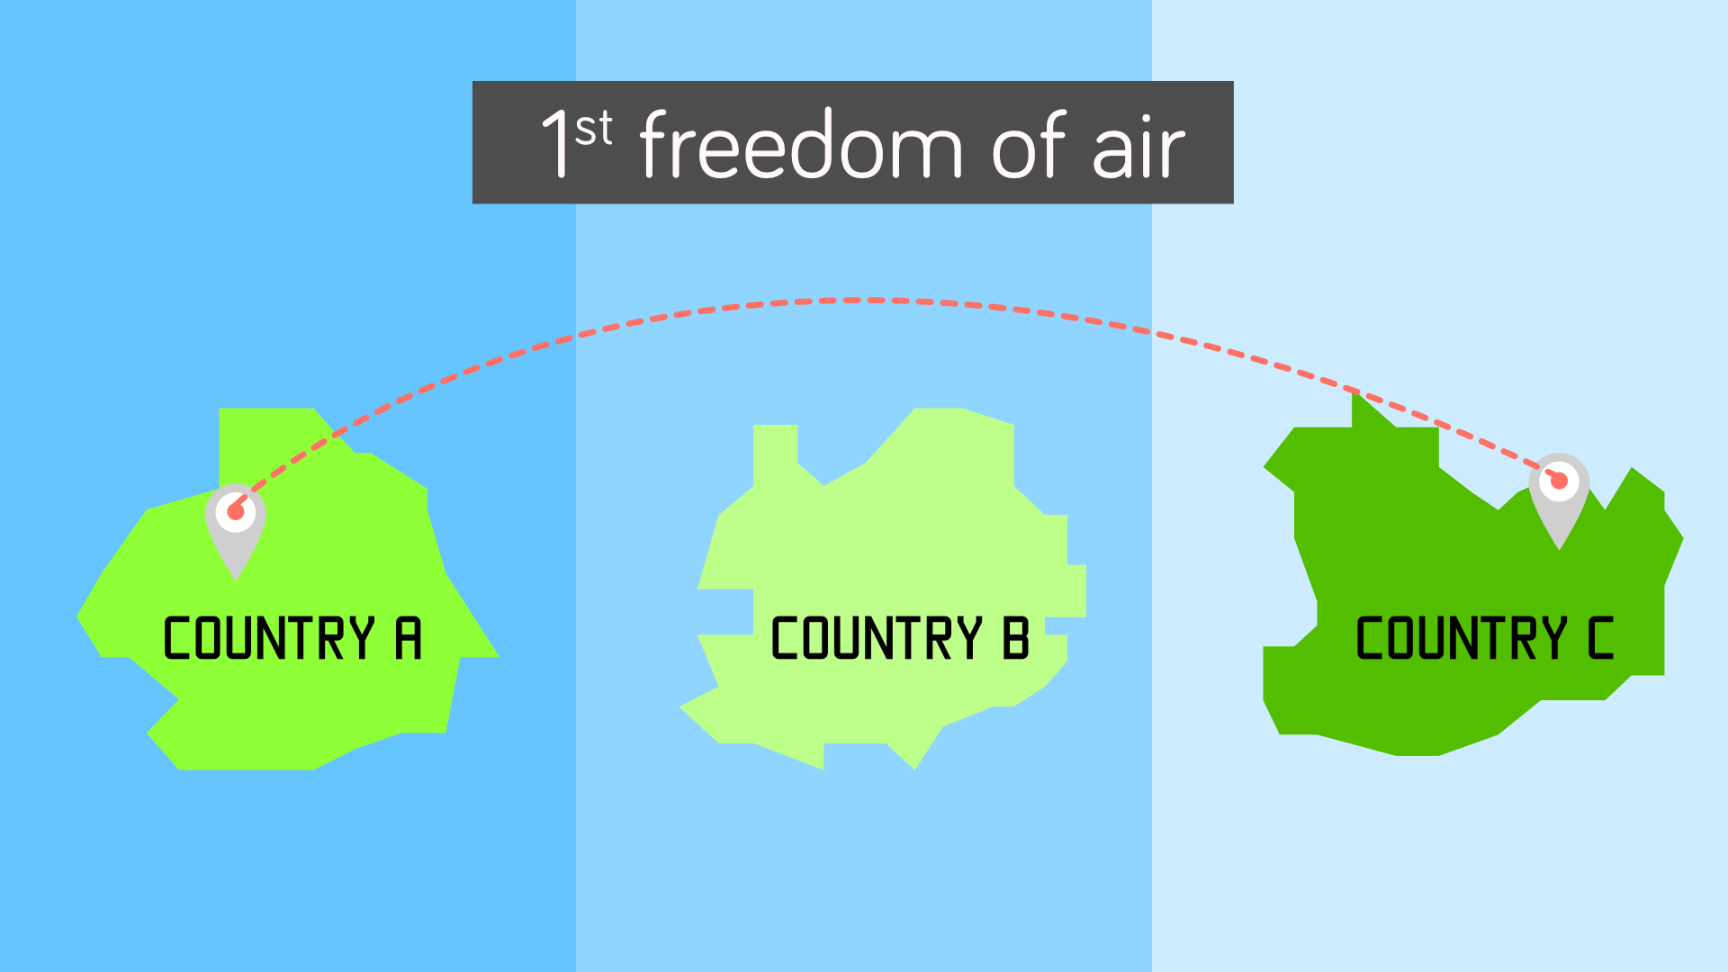
Freedom of peaceful transit. (with the consent of the state)

Slide 7
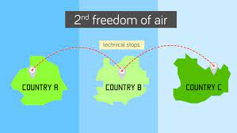
Freedom of non-traffic stop (to refuel, repair, or emergency landing). Informing the state is sufficient enough https://www.youtube.com/watch?v=AsLIGWtumd4 medical emergency Dubai-bound SpiceJet flight diverted to Karachi after medical emergency | Latest News | WION (youtube.com)

Slide 8
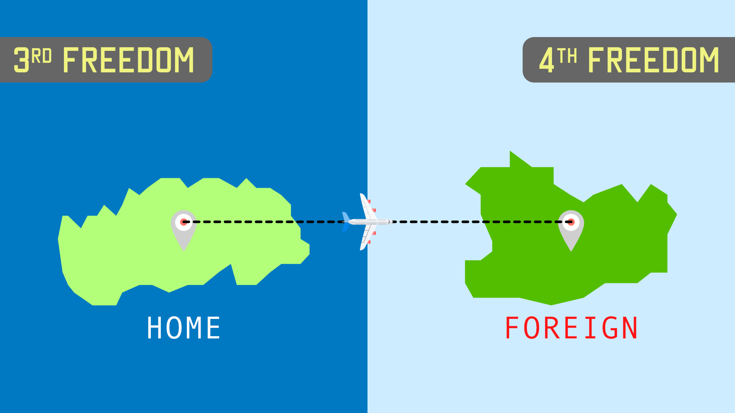
Freedom to take traffic from the homeland to any country.

Slide 9
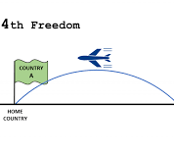
Freedom to bring traffic from any country to the homeland.

Slide 10
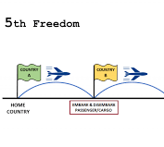
Freedom to pick up and discharge traffic at intermediate points.

Slide 11
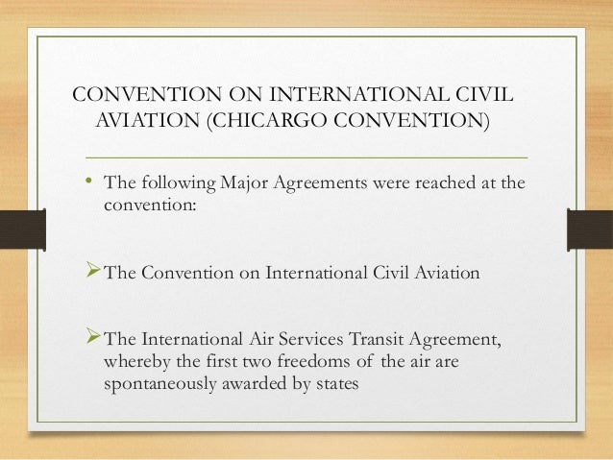
Chicago Convention 1944, led to formation of ICAO
Not all countries agreed to all the five
Some agreed to first two
And a group of others agreed to implement all five.

Slide 12
Chicago convention (ICAO) does not apply on
A) State aircraft (Air Force one)
Example https://www.youtube.com/watch?v=360_R1YstU0
B) Surveillance and Spy Aircraft
C) Unmanned Aircraft (Drone etc)
APPLY ONLY ON Civilian Aircraft

Slide 13
UNCLOS and Law of Air Space
UNCLOS 1984 says that beyond 12 NM from the baseline of a country having Sea, starts international airspace
Interestingly, the littoral states can exercise limited sovereignty over the water of EEZ or Cont. Zone, but it has no sovereignty over the airspace above EEZ.

Slide 14
UNCLOS and Law of Air Space
Some countries including Brazil contested that airspace over the EEZ should be consider equivalent to National Airspace (approached Chicago based International Civil Aviation organization, ICAO)
It was aimed at granting the states special rights to control the activities of military aircraft of other countries operating in the Sea
But ICAO declined their request and said that Freedom of overflight on high Seas and EEZ will remain unchanged.

Slide 15
Contestation over airspace over EEZ
Despite the UNCLOS coming into effect many countries including Argentina, Benin, Brazil, Congo, Ecuador, Elsalvador, Liberia, Nicaragua, Panama, Peru, Sierra Leone, Somalia and Uruguay have not left their contestation over the EEZ.
Brazil states: the provisions of the UNCLOS do not authorize other states to carry out military exercise or maneuvers in particular those involving the use of weapons, explosives, in the EEZ without the consent of the coastal state.

Slide 16
Even though US has not ratified the UNCLOS it asserts that the coastal state can assert its jurisdiction over the resources in the Sea.
Other activities including the military exercises will continue to be enjoyed by other states as has been the custom and practice and it is the internationally lawful use of the Sea.

Slide 17
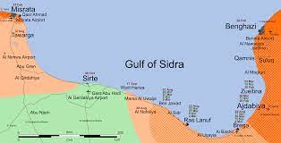
US’s response to Libya over Gulf of Sidra
In 1970s Libya claimed that the Gulf of Sidra is its “internal water and the airspace above the Gulf is part of Libyan national airspace, subject to its complete sovereignty.”
US objected to it. In 1986 it sent three vessels to Gulf of Sidra as part of Freedom of Navigation Operation to assert the right of all states to navigate in and above these waters.
Libya fired surface to air missiles against the US move and the US destroyed 4 Libyan vessels

Slide 18

US-China stand off in 2001
In April 2001, a US naval reconnaissance aircraft and a Chinese F-8 fighter collided over the South China Sea 70 NM south of Hainan island.
Ever since this incidence China claims that reconnaissance flight over EEZ of another country are threats to its national security and peaceful order as stipulated in international law violating UNCLOS and international law.

Slide 19
Origin of ADIZ
US was the first to announce Air Defense Identification Zone (ADIZ) over sea following the outbreak of Korean war in 1951.
The US ADIZs extend seaward of American coast line by 250 to 400 NM
“no person may operate an aircraft into or within an ADIZ unless the person files a Defense Visual Flight Rules (DVFR) flight plan containing the time and point of ADIZ penetration.”

Slide 20
The stated purpose for US ADIZ regulations is to ensure that all aircraft entering into US domestic air space provide their identification before entering in to its boundary.
After US, Canada, Japan, South Korea etc started imposing its ADIZ one after the other.
China is the latest to impose its ADIZ in November 2013.

Slide 21
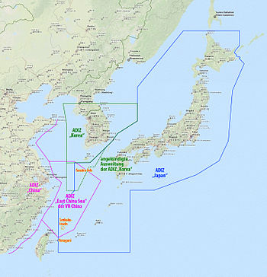
China’s ADIZ: a case Study
In November 2013 China’s enforced of its own defence zone, on the basis of its internal aviation laws and by citing “international practices”
It was aimed at asserting its sovereignty over the Senkaku/Diaoyu Island
China insists that its decision conforms to the “international practice.”

Slide 22
it wants all aircraft flying in the zone to follow the “instructions of the administrative organ of the East China Air Defence Identification Zone.”
The Chinese says:, “China’s armed forces will adopt defensive emergency measures to respond to aircraft that do not cooperate in the identification and refuse to follow the instructions.”

Slide 23
US and Japan flew its fighter jets to assess China’s preparedness and challenge its claim
But for its civilian aircrafts it has asked them to follow the Chinese ADIZ. (explain)
No major incident has happened but the experts believe that any miscalculation may lead to a conflict in the region.
The call is growing in the international community to make Int. Law related to ADIZ.

